Slide 1


UNDERSTANDING SCIENCE OF FOOD AND NUTRITION TOPIC -2 FOOD CONSTITUENTS

Slide 2
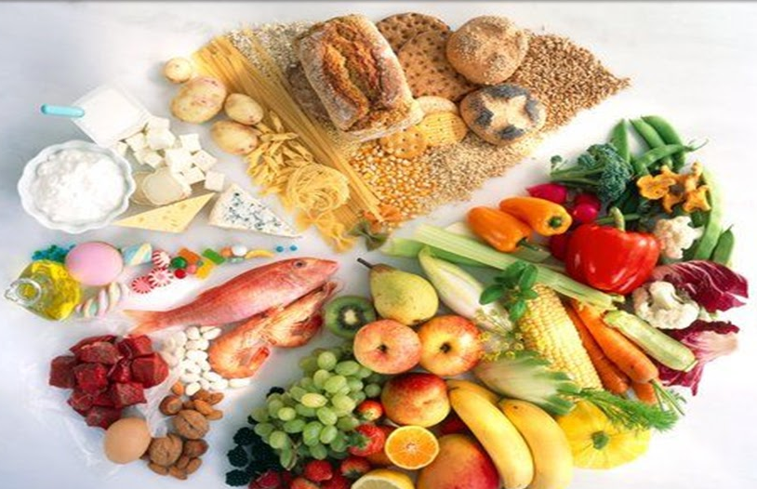
COMPONENTS OF FOOD
CARBOHYDRATES
PROTEINS
FATS
VITAMINS
MINERALS
ANTIOXIDANTS
WATER
FIBER

Slide 3
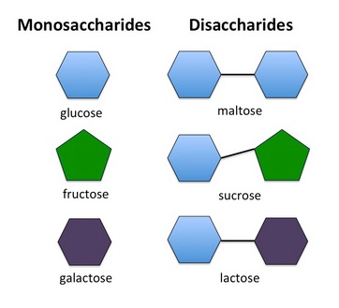
CARBOHYDRATES
Carbohydrates - Include the sugars, starches, gums and celluloses.
They are sugars, starches and fibers found in fruits, grains, vegetables and milk products. ..
Glucose is the simplest unit of carbohydrates.
The body breaks down most sugars and starches into glucose, a simple sugar that the body can use to feed its cells. Complex carbohydrates are derived from plants.
1gm carbohydrates yields 4 Kcal

Slide 4
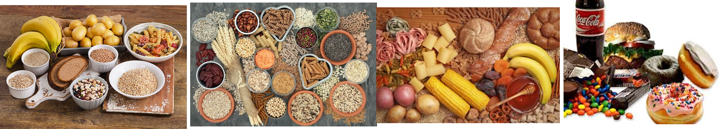
CARBOHYDRATES
Functions
Provide energy
Spare proteins for tissue building
Regulate fat metabolisms.
Help in gastro intestinal functions
Sources
Whole grains and Legumes
Roots and Tubers
Fruits like bananas, melons, and grapes
Sweets and Savories
Nuts: Almonds, walnuts, peanuts, etc.
Starchy vegetables like corn and peas.

Slide 5

Repeated washings of rice may result in lost of
Vitamins
Minerals
Both vitamins and minerals
Neither of vitamins nor of minerals
Food items containing starch change to which colour in presence of iodine?
Red
Purple green
Blue Black
Yellow

Slide 6
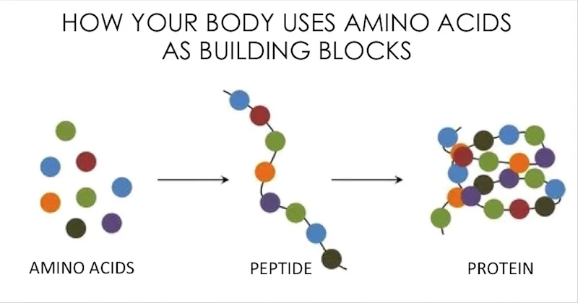
PROTEINS
Protein is a macronutrient that is essential to building muscle mass.
Protein makes up about 15 percent of a person's body weight.
Chemically, protein is composed of amino acids, which are organic compounds made of carbon, hydrogen, nitrogen, oxygen or sulfur.
Amino acids are building block of proteins
Each gram of protein yields 4 calories.

Slide 7
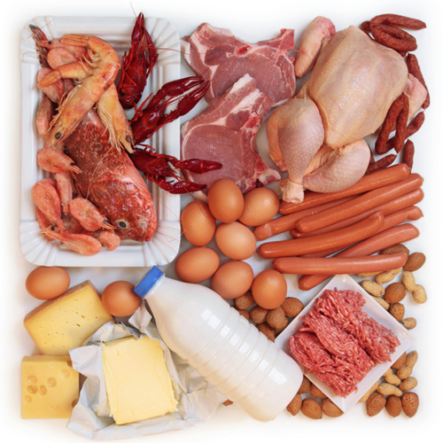
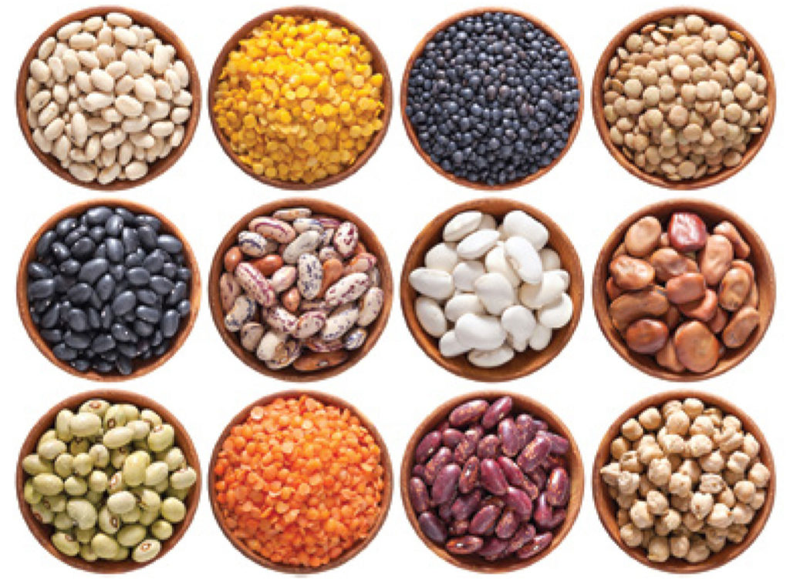
PROTEINS
Function:
They promote growth and development
Repair worn out tissues
Healing of wounds
Necessary for healthy teeth, bones, hair, and nails
Help in blood formation
Help in production of enzymes and hormones antibodies
Sources:
Animal protein Milk and milk products, poultry, fish, and egg, Meat and Meat Products
Vegetable protein Pulses and grams, legumes, seeds, nuts, and cereals

Slide 8
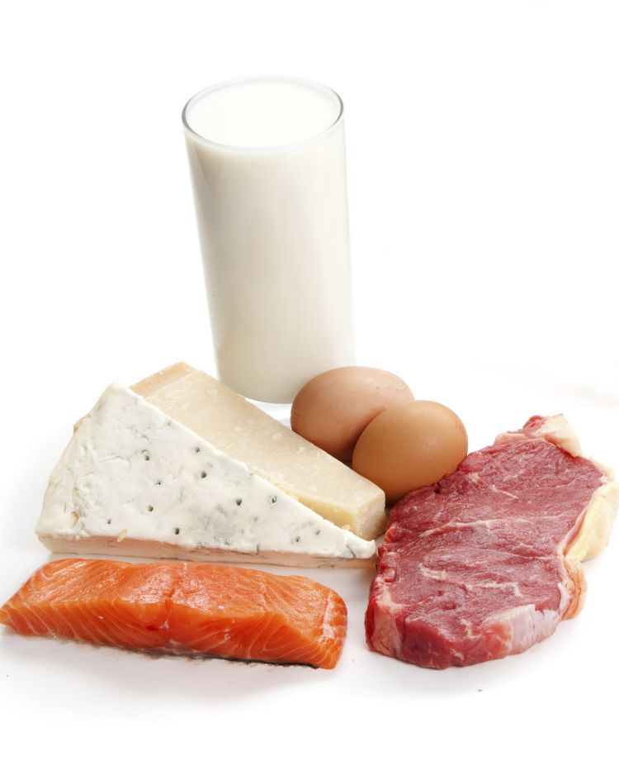
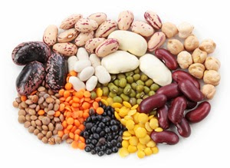
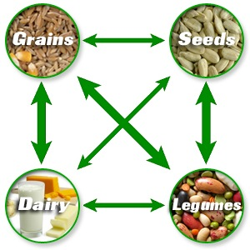
TYPES OF PROTEIN
Complete proteins: These foods contain all the essential amino acids. Examples: They mostly occur in animal foods, such as meat, dairy, and eggs.
Incomplete proteins: These foods contain at least one essential amino acid, so there is a lack of balance in the proteins. Examples: Plant foods, such as peas, beans, and grains mostly contain incomplete protein.
Complementary proteins: These refer to two or more foods containing incomplete proteins that people can combine to supply complete protein. Examples include rice and beans or bread with peanut butter.

Slide 9
Which of the following is a body building food?
Milk
Oil and fats
Fruits
Cereals
Egg
In addition to proteins and carbohydrates, the other elements of nutritional value in milk include
Potassium and iron
Calcium and potassium
Calcium, potassium and iron
Calcium and iron

Slide 10
FATS
Fats are a type of nutrient that you get from your diet (Sub group of Lipids)..
Lipids: This can refer to any type, regardless of whether it is liquid or solid.
Oils: This can describe any fat that is liquid at room temperature.
Animal fats: Among these are butter, cream, and fats in meats, such as lard.
Vegetable fats: Among these are the fats in olives and avocados, as well as olive, peanut, flaxseed, and corn oils.
Saturated and trans fats can raise cholesterol levels and increase disease risk.
Unsaturated fats support health and may be monounsaturated or polyunsaturated.

Slide 11
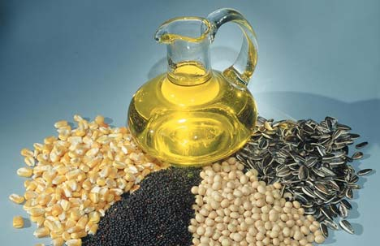
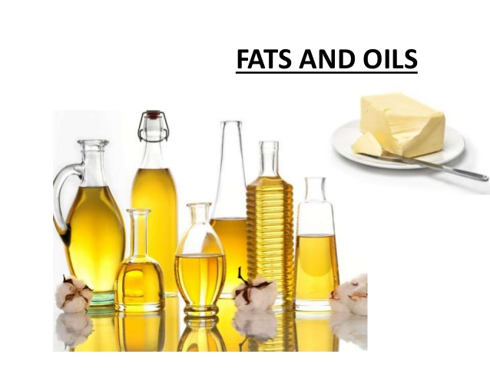
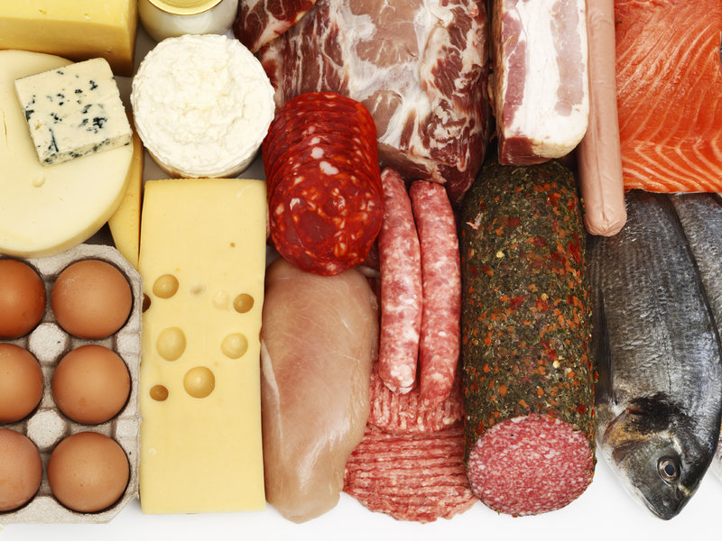
FUNCTIONS Provide energy Protects us from extreme temperatures Protect vital organs Acts as lubricant between joints Give a sense of fullness when eaten.
SOURCES:
Meats, dairy products, snack foods, and baked goods contain saturated and trans fats. Some sources of unsaturated — healthful — fats include nuts, oils, seeds, and avocados.

Slide 12
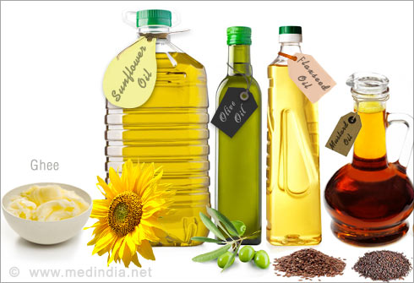
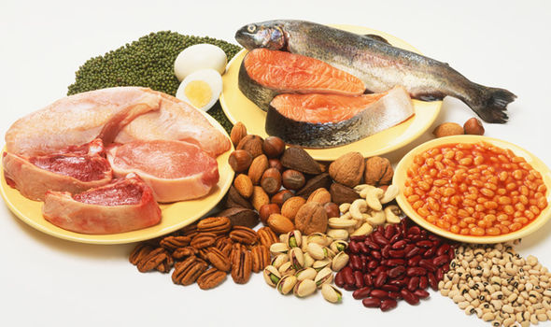
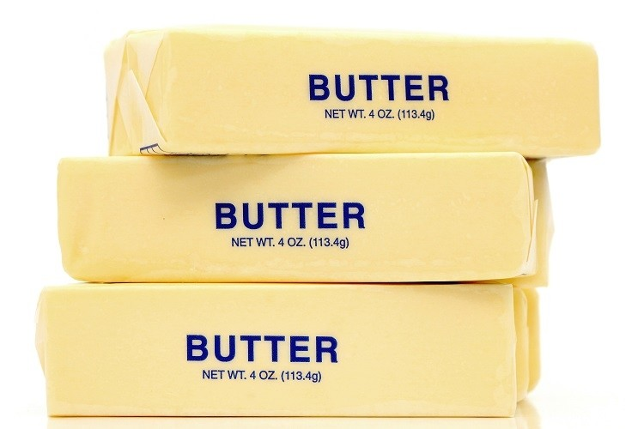
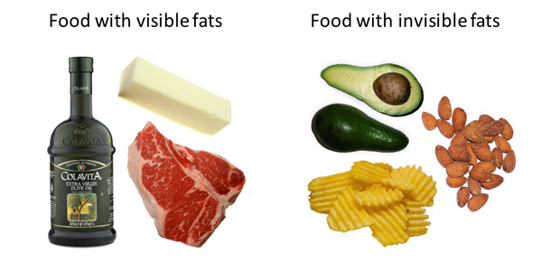
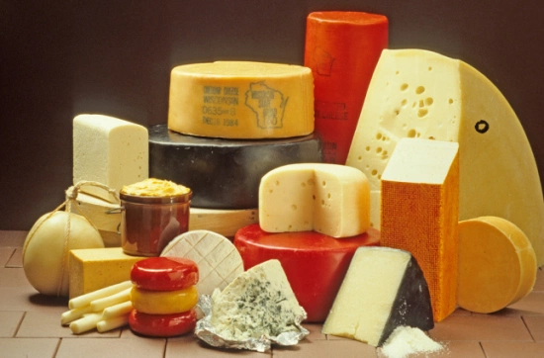
VISIBLE FATS
INVISIBLE FATS
1gm Fats yields 9 Kcal

Slide 13
The lipids that are found in food are made up of
Fatty acids
Amino acids
Carbolic acids
Carbonic acids
We consider eating fish to be healthy as compared to flesh of other animals because fish contains
Essential vitamins
Essential fatty acids
More carbohydrates and proteins
All the nutrients of food

Slide 14
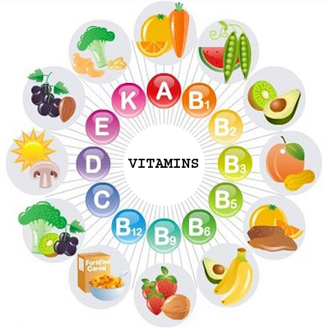
VITAMINS
A vitamin is an organic molecule that is an essential micronutrient which an organism needs in small quantities for the proper functioning of its metabolism.
Vitamins helps to keep our body healthy by protecting us from various diseases.
There are 13 vitamins your body needs

Slide 15
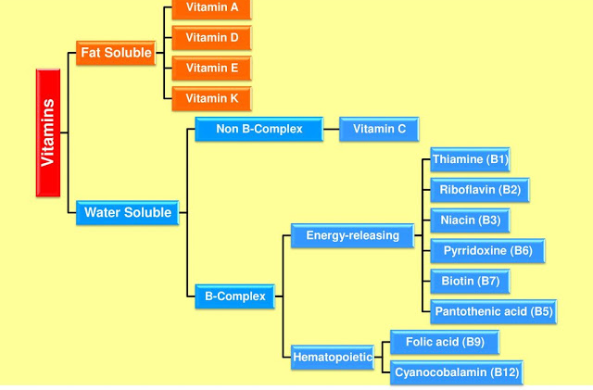
CLASSIFICATION OF VITAMINS

Slide 16
FAT SOLUBLE VITAMIS
Vitamins | Functions | Sources
Vitamin A | Needed for vision, healthy skin and mucous membranes, bone and tooth growth, immune system health | Vitamin A from animal sources (Retinol): fortified milk, cheese, cream, butter, fortified margarine, eggs, liver Beta-carotene (from plant sources): Leafy, dark green vegetables; dark orange fruits (apricots, cantaloupe) and vegetables (carrots, winter squash, sweet potatoes, pumpkin)
Vitamin D | Needed for proper absorption of calcium; stored in bones | Egg yolks, liver, fatty fish, fortified milk, fortified margarine. When exposed to sunlight, the skin can make vitamin D. (only 10% from diet)
Vitamin E | Antioxidant; protects cell walls | Polyunsaturated plant oils (soybean, corn, cottonseed, safflower); leafy green vegetables; wheat germ; whole-grain products; liver; egg yolks; nuts and seeds
Vitamin K | Needed for proper blood clotting | Leafy green vegetables such as greens, and spinach; green vegetables such as broccoli, Brussels sprouts, and asparagus; also produced in intestinal tract by bacteria

Slide 17
WATER SOLUBLE VITAMINS
Vitamins | Functions | Sources
Thiamine (Vitamin B1) | Energy metabolism; important to nerve function | Whole-grain or enriched breads and cereals, legumes, nuts and seeds
Riboflavin (Vitamin B2) | Energy metabolism; important for normal vision and skin health | Milk and milk products; leafy green vegetables; whole-grain, enriched breads and cereals
Niacin (Vitamin B3) | Energy metabolism; important for nervous system, digestive system, and skin health | Meat, poultry, fish, whole-grain or enriched breads and cereals, vegetables
Pantothenic Acid | Energy metabolism | Widespread in foods
Biotin | Energy metabolism | Widespread in foods; also produced in intestinal tract by bacteria
Pyridoxine | Protein metabolism; helps make red blood cells | Meat, fish, poultry, vegetables, fruits
Folic Acid | Making DNA and new cells, especially red blood cells | Leafy green vegetables and legumes, seeds, orange juice, and liver; now added to most refined grains
Cyanocobalamine | making new cells; important to nerve function | Meat, poultry, fish, seafood, eggs, milk and milk products; not found in plant foods

Slide 18
EACH LINE DESCRIBES ABOUT _____ NUTRIENT
THE NUTRIENTS WHICH MAINLY GIVE ENERGY TO OUR BODY
THE NUTRIENTS THAT ARE NEEDED FOR THE GROWTH AND MAINTENANCE OF OUR BODY
A VITAMIN REQUIRED FOR MAINTAINING GOOD EYESIGHT
A VITAMIN THAT IS REQUIRED FOR REQUIRING FOR KEEPING OUR BONES HEALTHY

Slide 19
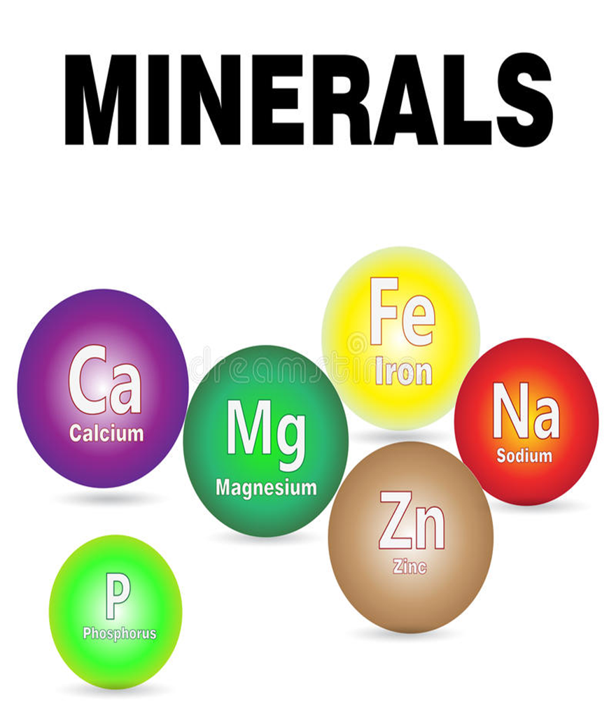
MINERALS
Mineral is a chemical element required as an essential nutrient by organisms to perform functions necessary for life
Minerals are found in foods like cereals, bread, meat, fish, milk, dairy, nuts, fruit (especially dried fruit) and vegetables.
The body uses minerals to perform many different functions — from building strong bones to transmitting nerve impulses. Some minerals are even used to make hormones or maintain a normal heartbeat.

Slide 20
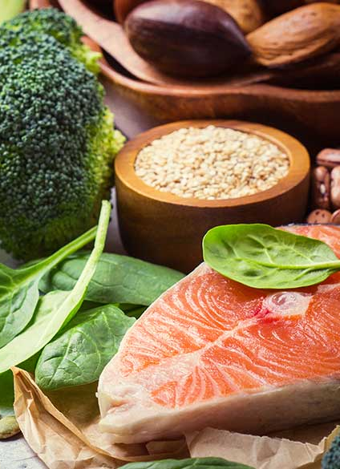
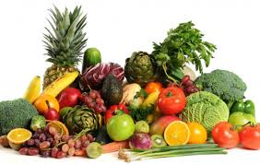
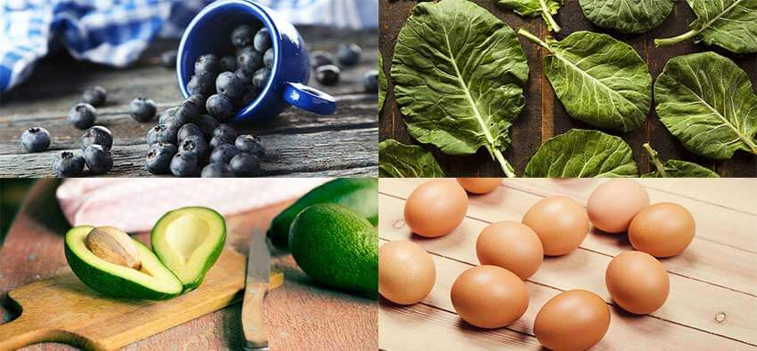
Trace minerals
Chromium.
Copper.
Fluorine.
Iodine.
Iron.
Zinc.
Manganese.
Molybdenum.
Selenium.
Major minerals
Calcium.
Chloride.
Magnesium.
Phosphorus.
Potassium.
Sodium.
Sulphur.
SOURCES

Slide 21
SOURCES OF MINERALS
Nutrient | Major Food Sources
Calcium | Breast milk, yogurt, cheese, fortified or enriched grain products, some green leafy vegetables, sardines, salmon
Iron | Breast milk; meat; liver; legumes; whole- grain breads, cereals, or fortified or enriched grain products; and dark green vegetables
Zinc | Breast milk; meat; liver; egg yolk; oysters and other seafood; whole-grain breads, cereals, and other fortified or enriched grain products; legumes
Iodine | Breast milk, seafood, iodized salt
Magnesium | Breast milk; whole-grain breads, cereals, and other grain products; tofu; legumes; green vegetables
Phosphorus | Breast milk; cheese; egg yolk; meat; poultry; fish; whole-grain breads, cereals, and other grain products; legumes
Potassium | Breast milk; fruits especially orange juice, bananas, and dried fruits; yogurt; potatoes; meat; fish; poultry; soy products; vegetables

Slide 22
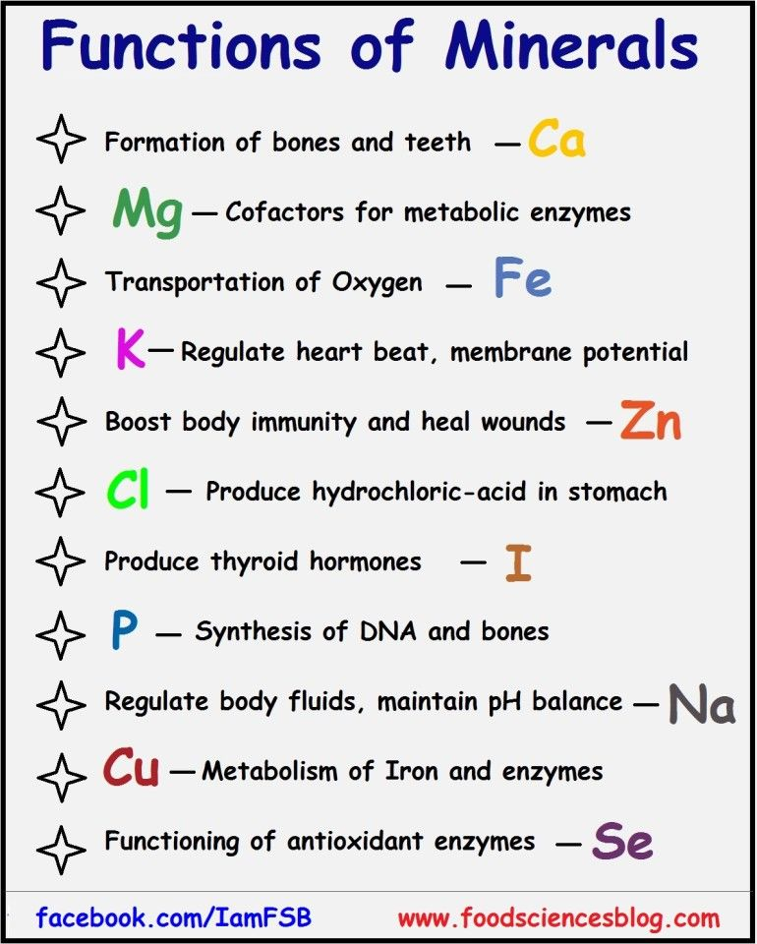
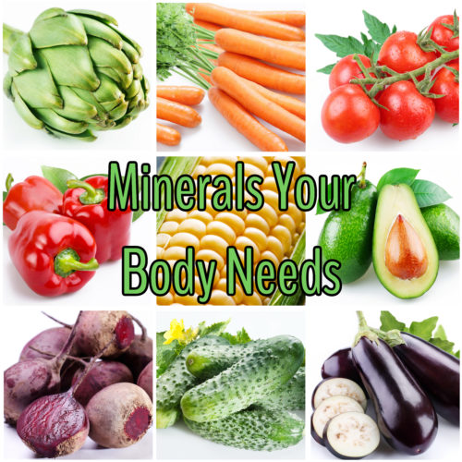

Slide 23
The Highest concentration of minerals is found in ____
Bones and Teeth
Arms and Legs
Skin
None of these
The mineral we get from fish is _____
Iron
Iodine
Magnesium
None of these

Slide 24
REFERENCE BOOKS
Food Science- Srilakshmi, Prosper Montague Publishing Group Ltd., Hamlyn, London. 2003.
Food & Nutrition- Swaminathan, The Bangalore Printing & publishing co ltd., Vol I, Second Edition, Bangalore (1995).
An Introduction to Lifestyle Management: Facilitator’s Handbook, Dr.Anja Morris-Paxton, 2019
DEVELOPED RESOURCE MATERIALS
FOOD CONSTITUENTS - Developed PDF attached in Ample course content
LOCAL VIDEO DEVELOPED:
https://youtu.be/cKRf53I737E - Video link is available in Ample course content

Slide 25
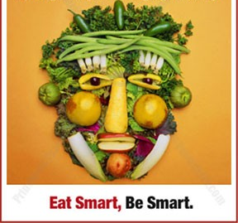
THANK YOU

